Slide 1
Anthropology of Death
A brief introduction to anthropology as a discipline and how we will be examining our specific topic

Slide 2
In this lecture
Brief overview of Anthropology as a discipline
Overview of major concepts & perspectives in anthropology that we’ll be using to study death
Overview of theoretical perspectives
(if there’s time) Introduction to rites and rituals

Slide 3
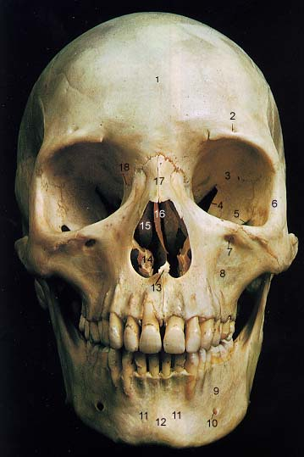

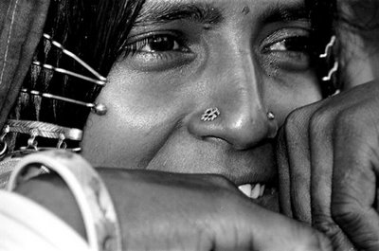
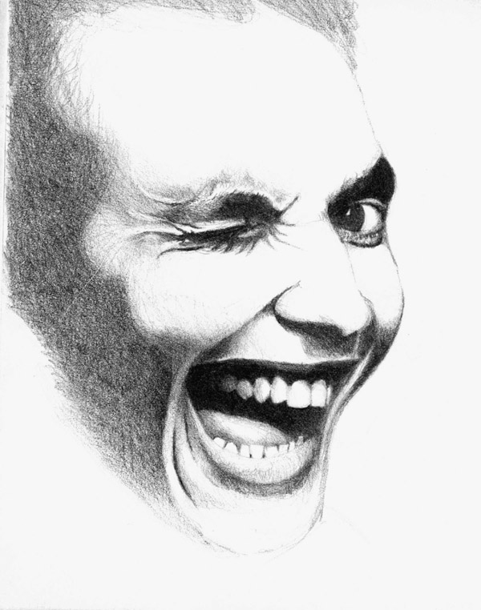
The Four Fields of Anthropology
Biological Anthropology
Archaeology
Applied
Cultural Anthropology
Linguistics

Slide 4
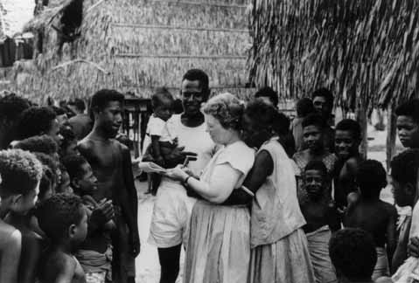
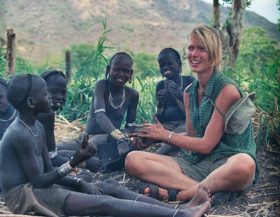
The Subdisciplines of Anthropology
Cultural Anthropology
Examines cultural diversity of the present
and recent past.

Slide 5
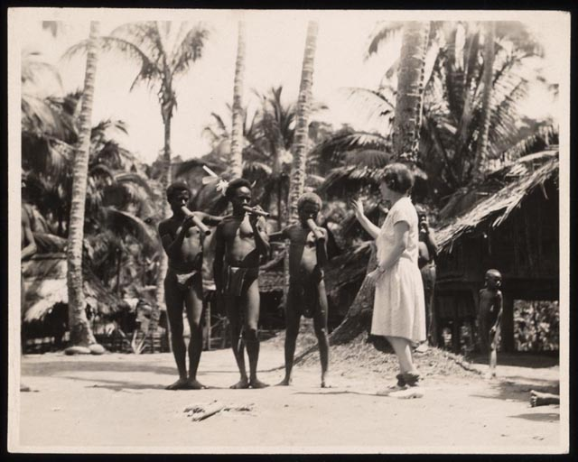
The Subdisciplines of Anthropology
Cultural Anthropology
Ethnography
Fieldwork in a particular culture
Account of a specific community, society, culture
Ethnology
Examines, interprets, analyzes results of ethnography
Uses ethnographic data to compare/ contrast/ make generalizations about society and culture
Uses data from other subfields (e.g., archaeology)
Ethnography & Ethnology – Two Dimensions of Cultural Anthropology
Ethnography | Ethnology
Requires fieldwork to collect data | Uses data collected by a series of researchers
Often descriptive | Usually synthetic
Group/community specific | Comparative/cross-cultural

Slide 6
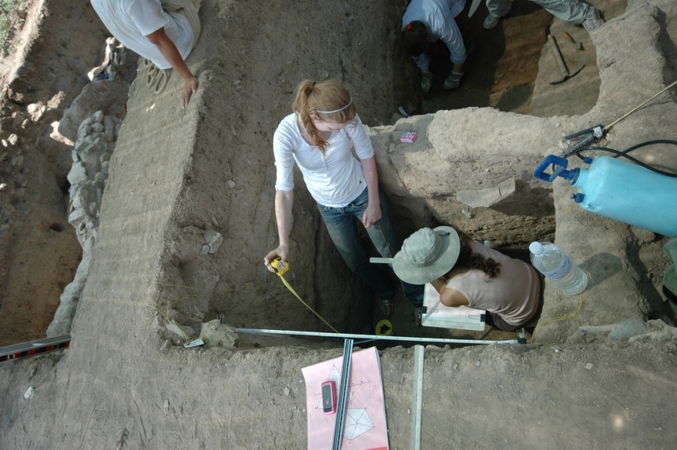
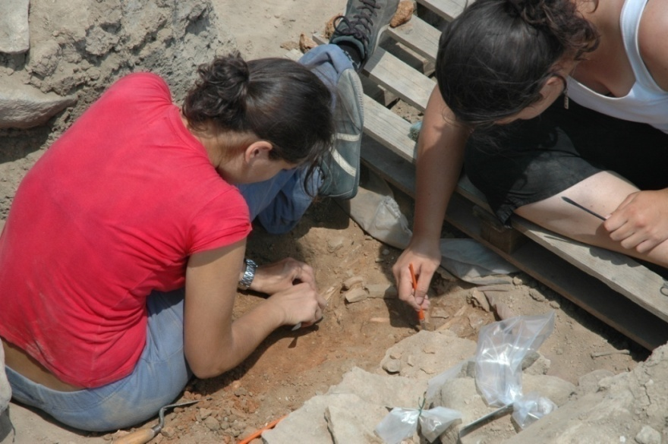
The Subdisciplines of Anthropology
Archaeology
Investigates how people lived in the past based on their material remains.

Slide 7
The Subdisciplines of Anthropology
Archaeological Anthropology
A cultural anthropology of the human past (most, but not all of the time) involving the analysis of material remains left behind.
4 main types of material remains:
  Artifacts
  Ecofacts
  Features
  Sites

Slide 8
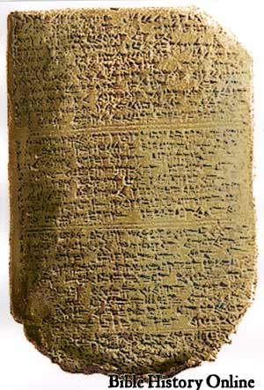
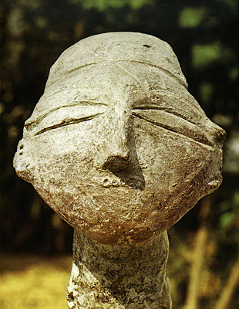
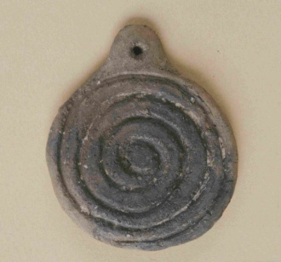
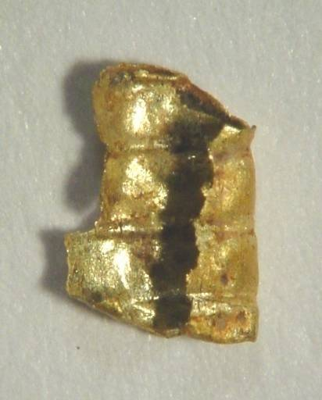
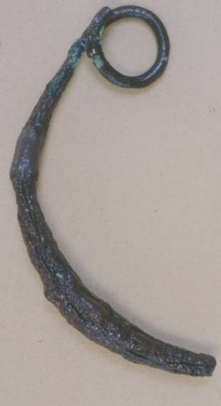
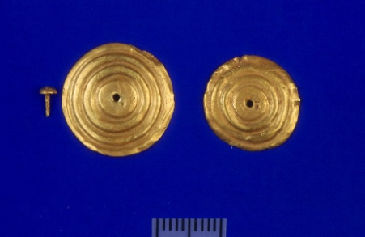
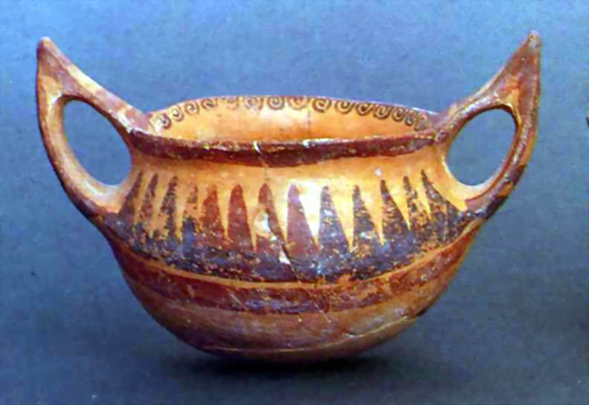
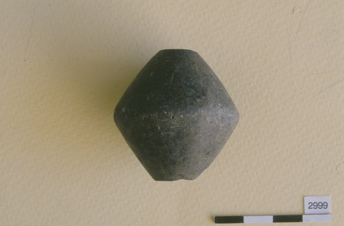
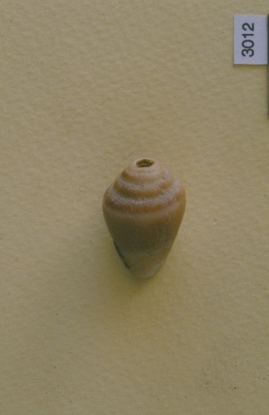
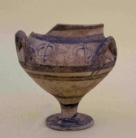
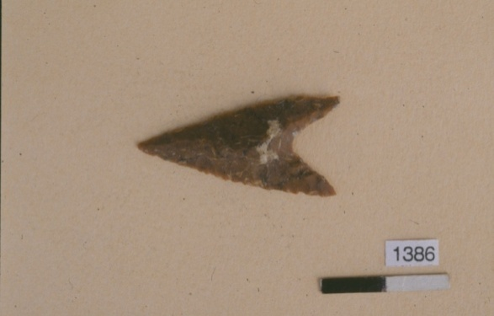
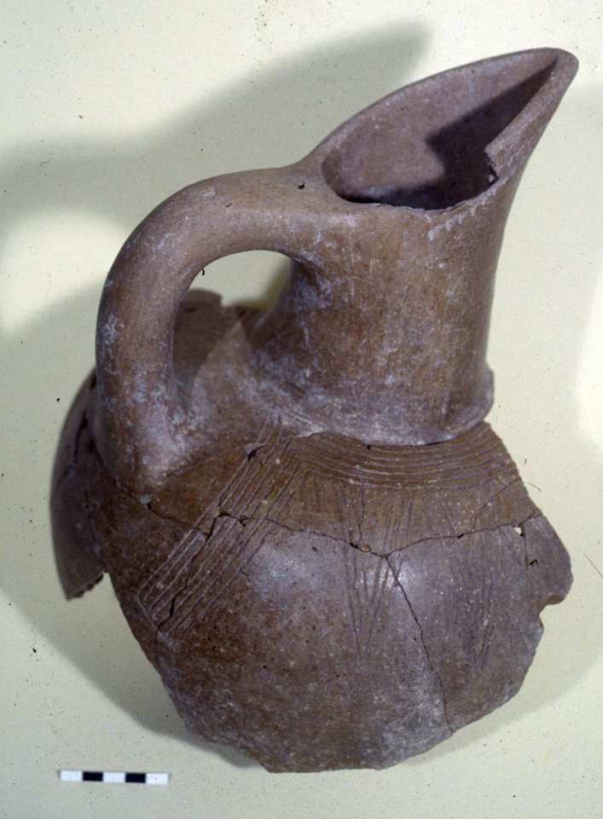
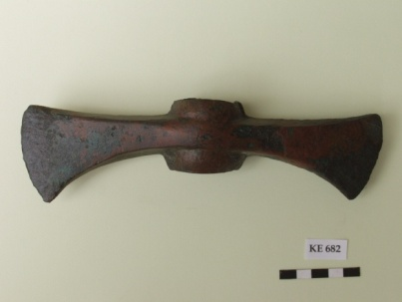
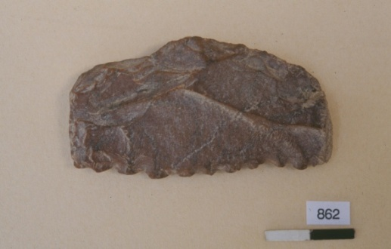
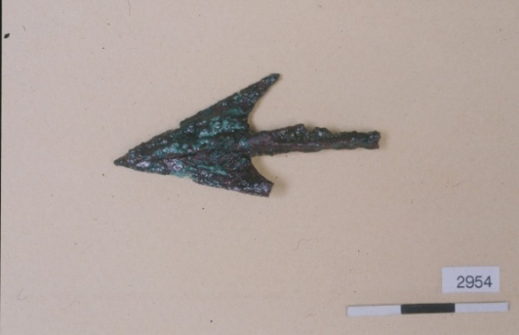
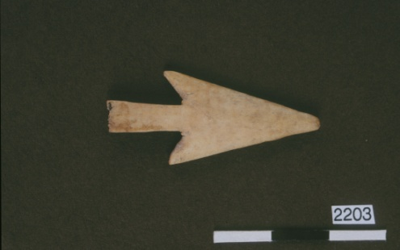
Artifacts
Artifacts
Notes:
Artifacts are portable objects made and used by humans (e.g., potsherds, tools, jewels)

Slide 9
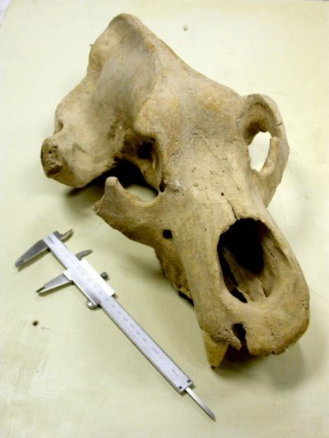
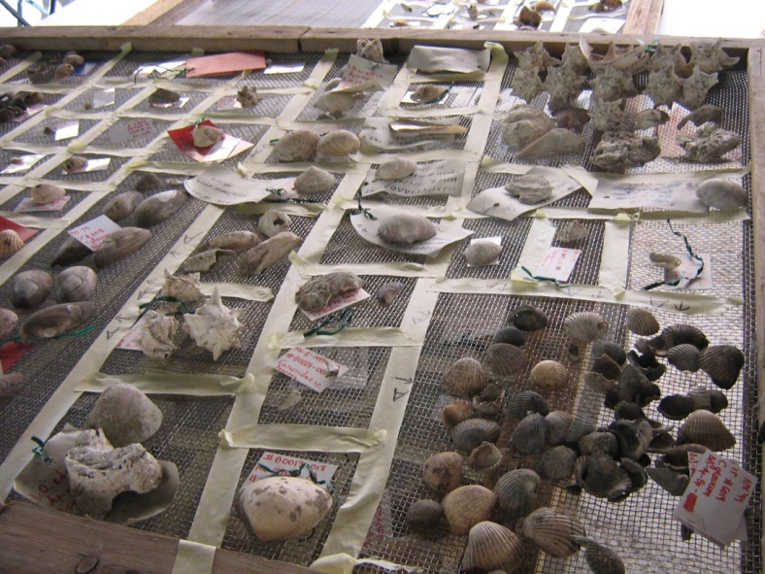
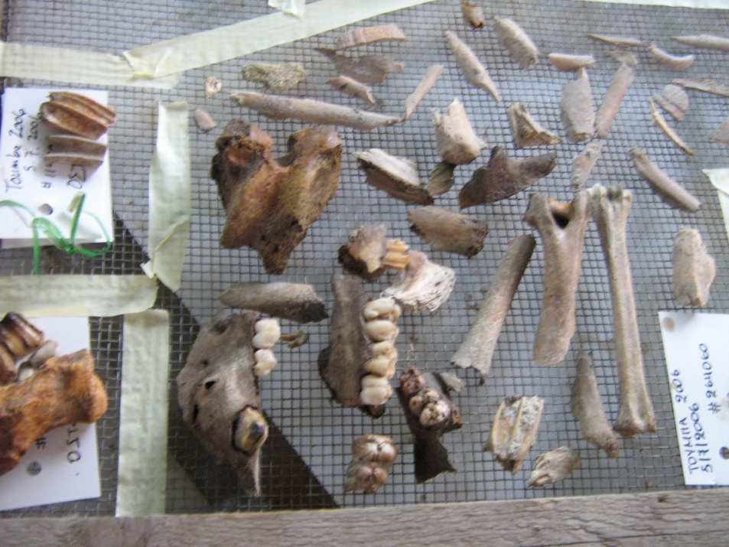
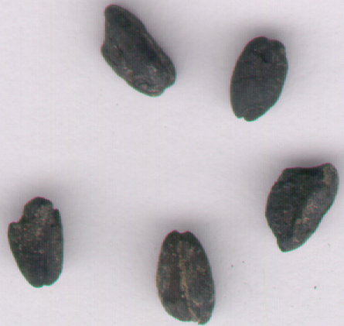
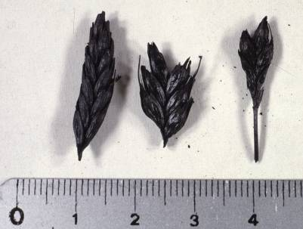
Ecofacts
Notes:
Ecofacts are organic and environmental remains not made by humans)

Slide 10
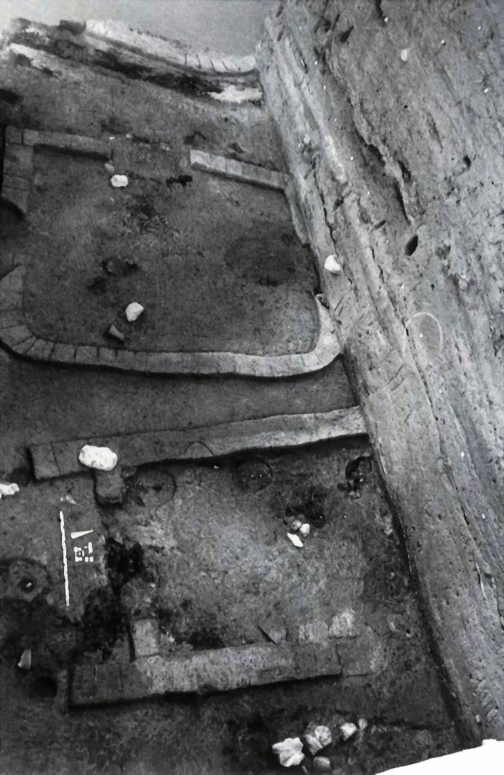
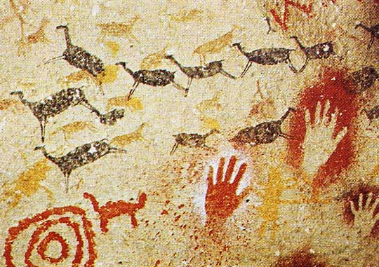
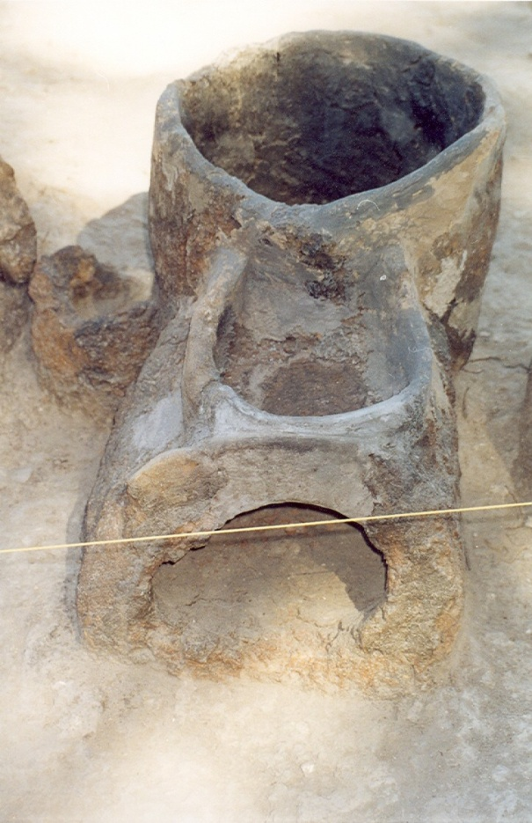
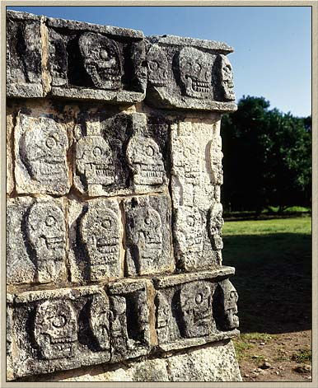
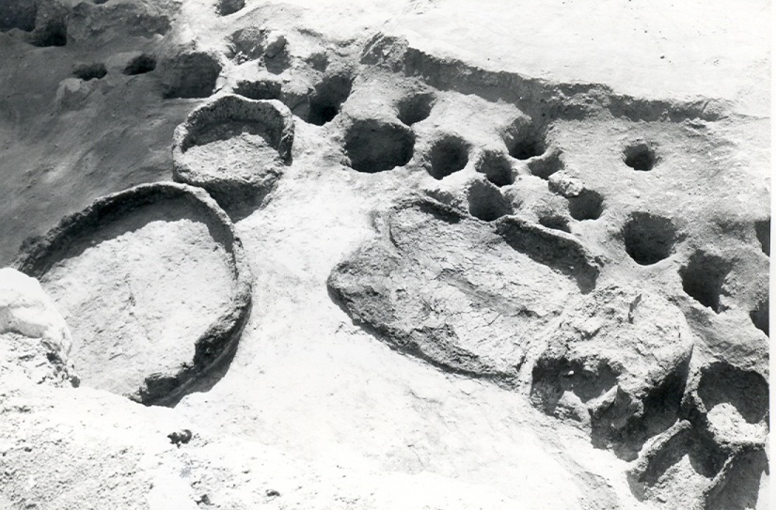
Features
Notes:
Features are non-portable artifacts (e.g., remains of structures/ architecture)

Slide 11
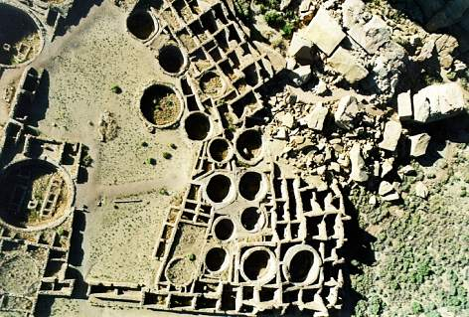
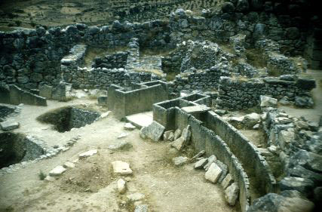
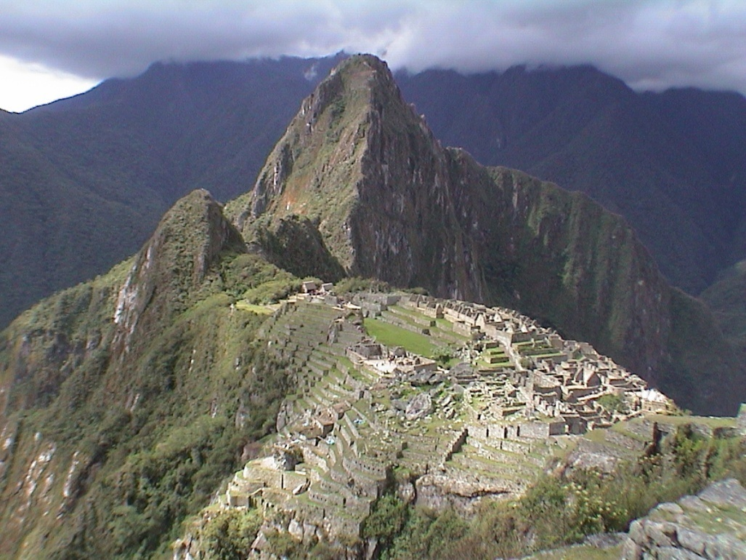
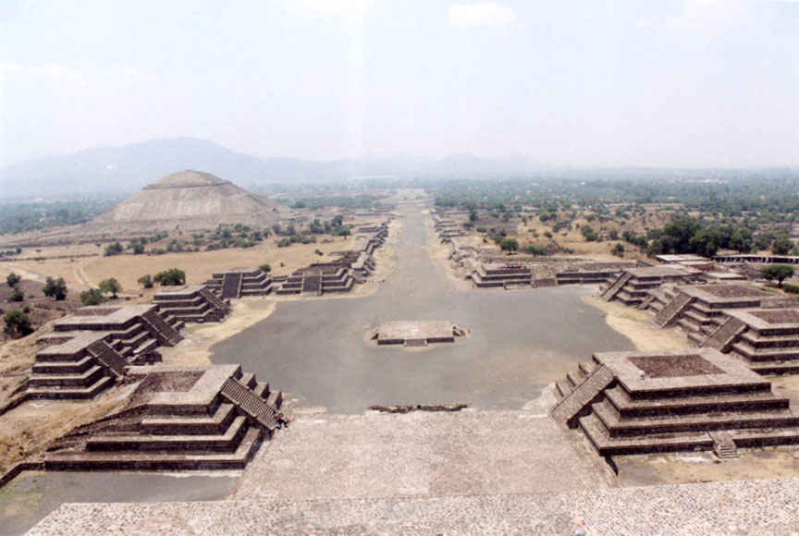
Sites
Notes:
Sites are places where artifacts, ecofacts, features, and (sometimes) human remains are found together.

Slide 12
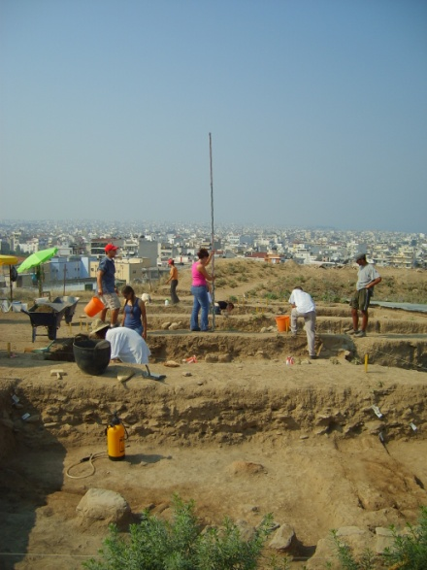
The Subdisciplines of Anthropology
Archaeological Anthropology
Archaeologists do not just study prehistoric people. They also study the cultures of historical and living people.
Historical Archaeology combines archaeological data and textual data to reconstruct historically known groups.
“Garbology” (Rathje, 1973) studied contemporary life through modern garbage.
Funerary Archaeology examines burials and the cultural behaviors, traditions, beliefs and rituals surrounding how individuals are treated after death. Often overlaps with Bio Anth subdisciplines.
Notes:
Historical archaeology can include slave cemeteries, colonial sites, civil war sites and battlefields, or even things like medieval churches and monasteries.
Rathje’s work in garbology showed that what people report may contrast with real behavior.
The subdiscipline of funerary archaeology, though, is what we’ll be focusing part of our class on.

Slide 13
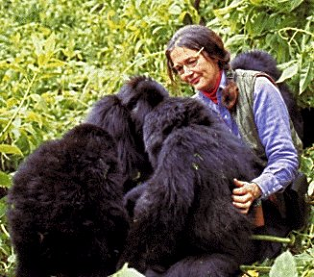
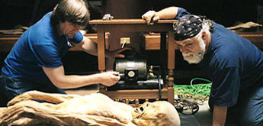
The Subdisciplines of Anthropology
Biological Anthropology
Studies human fossils, genetics, and bodily
growth, as well as non-human primates.

Slide 14
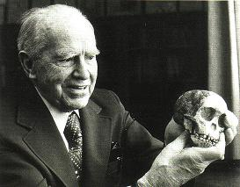
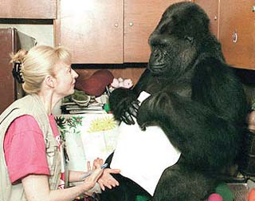
The Subdisciplines of Anthropology
Biological or Physical Anthropology
Paleoanthropology
Human genetics
Human growth and development
Human biological plasticity
Forensic Anthropology
Primatology
Notes:
Paleoanthropology studies human evolution as revealed by the fossil record.
Human Biological plasticity: Body’s ability to change.
Primatology: biology, evolution, behavior, and social life of monkeys, apes, and other nonhuman primates.
Forensic Anthropology applies the science of biological anthropology to the legal process. Forensic anthropologists assist in locating and recovering human skeletal remains, and assess the age, sex, ancestry, stature, pathological conditions, and unique features of skeletal remains found in a variety of contexts.
For us, we’ll be examining how we study human growth and development, as well as various aspects of Forensic Anthropology.

Slide 15
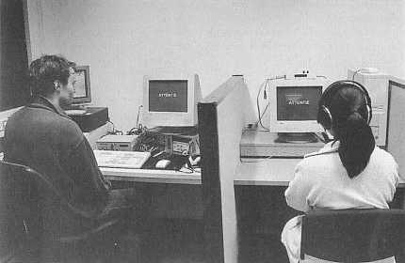
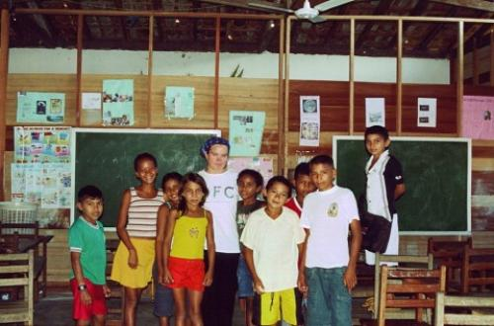
The Subdisciplines of Anthropology
Linguistic Anthropology
Examines how speech varies with social
factors and over time.
Notes:
Linguistics is really the one anthropological subfield we won’t really get into much, but its something to be aware of, and included when we’re giving just a general overview of the discipline. It’s a fascinating subfield, and overlaps pretty heavily with history and Applied Linguistics.

Slide 16
General Anthropology: The Four-Field Approach
All four sub-disciplines influence each other, and all have an applied component.
All anthropologists share the assumption that “human nature” cannot be understood from studying a single nation, society or cultural tradition. A comparative, cross-cultural approach is essential.
Notes:
It is this type of approach that we will be using to examine the topic of death, and this topic really highlights how the many of the subfields overlap and influence each other in how we study and conceptualize death across various cultures and time periods.
But first, there’s some overarching concepts within the discipline that we’ll be using and that should be introduced, especially for those who don’t have any experience or background within the discipline.

Slide 17
What is Culture?
Culture: Sets of learned behavior and ideas that human beings acquire as members of society.
Humans use culture to adapt to and to transform the world in which they live.
Culture is what makes us unique
Notes:
In Anthro, culture is central to explanations of why we are the way we are, and why we do what we do.

Slide 18

CULTURE & THE INDIVIDUAL
AGENCY & PRACTICE

Slide 19
CULTURE & THE INDIVIDUAL
Is each and every one of us constrained by the culture, the social rules, and the actions of other individuals who live around us?
Or are we completely independent?

Slide 20
CULTURE & THE INDIVIDUAL
Is each and every one of us constrained by the culture, the social rules, and the actions of other individuals who live around us?
Or are we completely independent?
Agency: the capacity of individuals to act independently and to make their own free choices. The actions that individuals take, both alone and in groups, in forming and transforming cultural identities.

Slide 21
CULTURE & THE INDIVIDUAL
“System”: various concepts - society, social relations, social structure
“Individual”: a person/ individual human being that constitutes (is part of) the “System”
Notes:
A little bit of both. We use our culture creatively; we are not passively dominated by our cultural traditions.
We have the ability to avoid, manipulate, subvert, and change the “rules” and patterns of our own cultures.
You’ll see this most heavily when we look at burials in ancient societies and how they used the mortuary sphere a bit more actively than we do today.

Slide 22
CULTURE & THE INDIVIDUAL
“Ideal culture”: what people say the should do and what people say they do.
“Real culture”: actual behavior as observed by the anthropologist.
Notes:
Some anthropologists find it useful to
distinguish between “ideal culture” and
“real culture”.

Slide 23
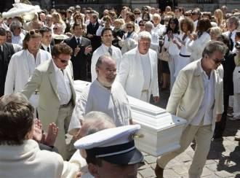


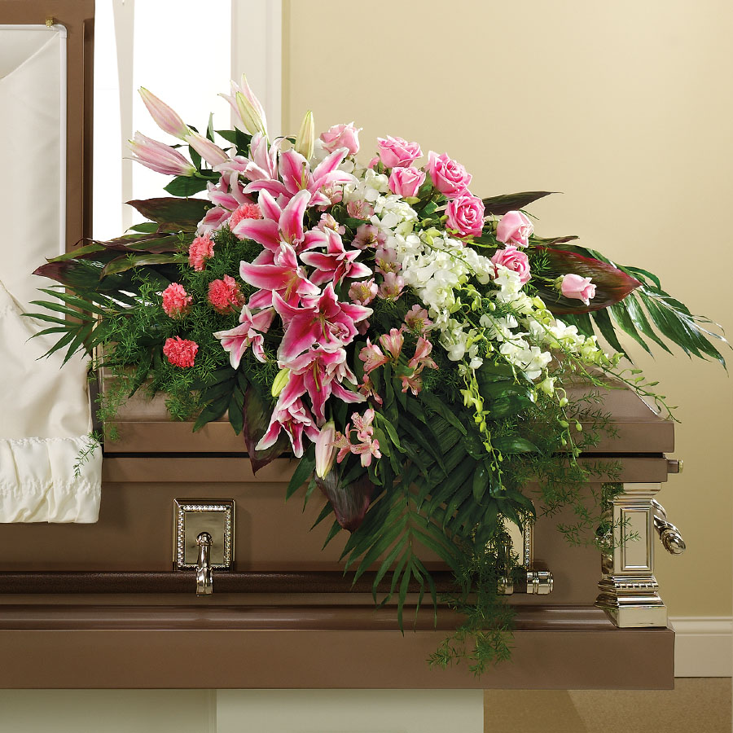

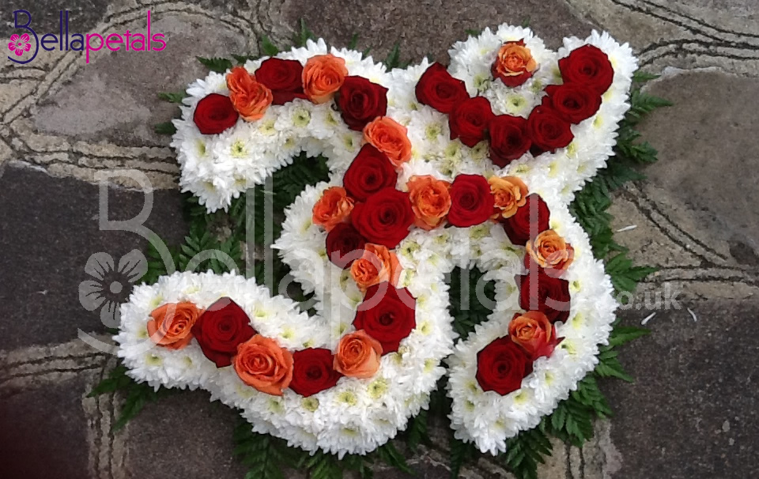
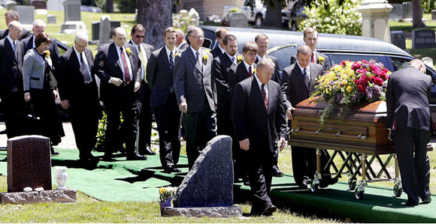
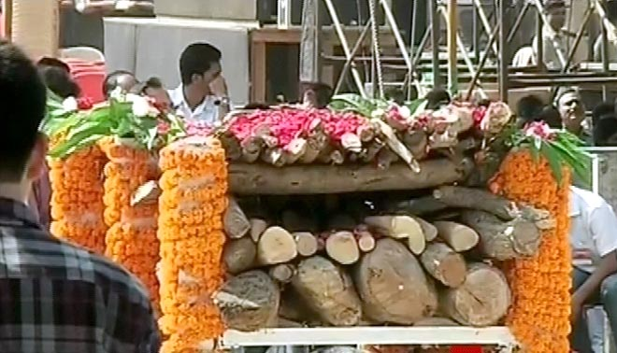
Notes:
Culture is contested, and “common symbols” may have radically different meanings to different individuals and groups in the same culture.

Slide 24
CULTURE & THE INDIVIDUAL
Culture is no longer seen as an entity: culture is a process.
Today anthropologists emphasize how day-to-day action, practice, or resistance can make and re-make culture.

Slide 25


ETHNOCENTRICISM, CULTURAL RELATIVISM
HUMAN RIGHTS
Notes:
There are some key concepts involved in studying cultures. This includes ethnocentrism, cultural relativism, and human rights, which will play into our study of the mortuary practices and rituals of various cultures

Slide 26
ETHNOCENTRISM
Ethnocentrism: the tendency to view one’s own culture as superior and to apply one’s own values in judging the behavior and beliefs of people raised in other cultures.
Ethnocentrism is a cultural universal.
Ethnocentrism contributes to social solidarity, a sense of value and community, among people who share a cultural tradition.

Slide 27
CULTURAL RELATIVISM
Cultural relativism: behavior in one culture should not be judged by the standards of another culture.
At its most extreme: the moral and ethical rules of all cultures deserve equal respect.

Slide 28

CULTURAL RELATIVISM
Nazi atrocities
Female genital mutilation (FMG)
Can we be non-judgmental?

Slide 29
INALIENABLE HUMAN RIGHTS
Inalienable: nations cannot abridge or terminate them
Human rights are vested in individuals and include the right to speak freely, to hold religious beliefs without persecution, and not to be murdered, injured, enslaved, or imprisoned without charge.
Cultural relativism is not a moral position in anthropology, but a methodological one.
Atrocities: There is a moral obligation to stop doing anthropology and take action to intervene.
Notes:
The idea of universal, inalienable, individual human rights challenges cultural relativism by invoking a moral and ethical code that is superior to any country, culture, or religion.

Slide 30
Theory in Archaeology and Biological Anthropology
Notes:
I’m going to introduce some of the broad overarching perspectives in anthropology and archaeology that the discipline has moved through, before I go into the specific perspectives we’ll be using in this class.

Slide 31
Why Use Theories?
Provide models to help answer questions of how and why things happened the way they did.
Can meet the goal to reconstruct, describe, and explain past human behavior.
Provides a framework and set of questions to help guide our research.

Slide 32
Culture-History Perspective
Normative model of culture
  A culture is a set of rules or norms that govern behavior of a particular society
  These rules are passed from generation to generation
  Because learning rules of behavior is not perfect, a degree of change in the normative system is inevitable
  Some behavior is idiosynctratic – unique to the individual – and may not be perpetuated
  In any given culture, a range of behaviors is tolerated for each situation.

Slide 33
Culture-History Perspective
Assume material remains reflect behavioral norms.
  Ex: Pottery is a good indicator of culturally controlled behavior
Emphasizes the goal of outlining the sequence (time) and geographical distribution (space) of past cultural norms
Then applies descriptive models, usually drawn from ethnography and history, that describe the mechanism most likely to have been involved in stability and change
Notes:
Although the methods for making and decorating pottery are many and varied, each society uses only a few of these techniques, learned by each potter as an apprentice. Departures from these manufacturing norms are usually discouraged by social and economic sanctions. Archaeologists, therefore, can infer the ancient rules governing pottery-making by studying shared characteristics in the surviving ceramics.

Slide 34

Notes:
Culture history approach leads to the developments of time-space grids, like this one for the southwestern US, to summarize ancient events and cultural relationships

Slide 35


Slide 36
Processualism
AKA: the “New Archaeology”
Lewis Binford, 1960’s
Seeks to explain the processes of culture by discovering the causes of change both from internal factors and from external cross-cultural interactions
Notes:
Sought a more scientifically-oriented approach to archaeology
How the component parts of a culture function as a system and at one point in time and how cultures change over time

Slide 37
Processualism
Ecological Model
  Emphasizes a synchronic (existing at one time) view of culture
  Portrays culture, especially technology, as the primary means of adapting to the environment (analog in biology)
  Highlights variation in cultural forms (ex: spear points = hunting; horticultural tools = cultivate different crops)
  Sees change as stemming from alteration of the adaptive relationship between culture and environment, reflected archaeologically in new forms or new frequencies of particular material remains.

Slide 38
Processualism
Materialist model:
  Emphasizes a diachronic/evolutionary view of culture
  There are biological and psychological needs common to all humans, such as hunger, sex and shelter. How these shared needs are met in different societies provides a means for evaluating each society’s adaptive efficiency by measuring input, output, costs and benefits.
  Needs are satisfied by infrastructure (technology, economy, demography
  Change in infrastructure = change in social, political & ideological systems

Slide 39
Processualism
Begins with hypothesis that specifies the working model of change or interaction, and the kinds of data that will support or refute each hypothesis
Competing hypotheses are tested against the data to eliminate those not supported by the evidence
Built on a culture-history foundation
Notes:
Ones that are supported are retested and refined by further research to isolate the factors involved in a given situation of cultural change

Slide 40

Notes:
Example of a cultural system is shown in the related activities (components) of food acquisition used by Shoshonean peoples of the Great Basin in the western US

Slide 41
Post-Processualism
Response to Processualism – calls for more humanistic approach
View the past as dependent on the specific conditions and perspectives of the society being investigated
Recognizes the importance of nonmaterial factor’s in people’s lives

Slide 42
Post-Processualism
Calls for a model that focuses on the human ability to create and modify idea systems as an important source of how societies operate and change
Focus on small-scale behaviors at the level of the individual, family or ethnic group.
Focus on insider’s perspective, trying to see how the people who created the material remains saw their own world
Notes:
Treat time as more like a continuous flow in which people live their lives – not as a large, undivided blocks where a society is working in a system.

Slide 43
Post-Processualism
Ian Hodder: Reflexive method
  Evidence does not exist apart from interpretation and theory
  Methods emphasize constant and continuous interpretation and reinterpretation
  Encourages diverse observers to contribute to the interpretive stream - a single interpretation is not the goal
Notes:
Archaeological record is examined for regularities and patterns, and these patterns are interpreted based on propositions that can be tested by data from subsequent research
But still recognizes human agency within those patterns and regularities.

Slide 44
Post-Processualism
Seek meaning beyond the technological, environmental, and social dimensions
Archaeological record should be viewed from multiple perspectives and seen as possessing multiple meanings
These different levels of meaning should not be seen as mutually exclusive
Notes:
The main Importance is to attempt to understand as many aspects of past human behavior as possible.

Slide 45
Gender in Funerary Archaeology
Subset of Post-processualism
Understanding of how people come to understand themselves as different from others
How people represent these differences, and how others react to such claim
Shifts attention away from universals & focuses on detailed contextual features on a site-by-site basis
Rejects the “normative” two-sex/two-gender model
Notes:
Gender archaeology: “addresses the needs of contemporary gender studies for an understanding of how people come to understand themselves as different from others; how people represent these differences; and how others react to such claims.”
“The experiences of people in the contemporary world are actually a good deal more varied than those expected under the normative two-sex/two-gender model.
Gender archaeologists have found that new questions can be asked about variation in sex, gender, and other kinds of human difference in past societies if attention shifts away from the universals and focuses instead on detailed contextual features of specific archaeological sites.

Slide 46
Feminist Archaeology
Rejects biological determinism of sex roles
Argues that cultural and historical factors are responsible for how a society allocated tasks, which can change over time
Goal is to develop a view of the past that focuses on people as social agents
Notes:
“By the 1980s, awareness of the unequal treatment of women in modern European and American societies had led archaeologists to examine why women’s contributions had been systematically written out of the archaeological record.
“Feminist Archaeology rejected biological determinism of sex roles, arguing that cultural and historical factors were responsible for how a society allocated tasks and that this allocation could change over time. The goal was to develop a view of the past that “replaces focus on remains with a focus on people as active social agents”.
Merely asked new kinds of questions.

Slide 47
Approaches to the study of the funerary record

Slide 48
Some key themes in mortuary studies
Treatment of the dead is bound with ritual and beliefs
Social identities are often reflected in funerary practices
Funerary practices can be vehicles for political/social/economic advancement and consolidation
Mortuary studies, including funerary archaeology and forensic anthropology, isn’t just about dead bodies

Slide 49
Ethnoarchaeology
Ethnoarchaeology = the study of contemporary societies by archaeologists
Ethnoarchaeology relies on the use of analogy i.e. the correspondence of one thing to another.
Ethnography for archaeologists = the use by archaeologists of information collected by anthropologists and ethnographers
Notes:
We’ll deal with ethoarchaeology a bit when we look at past mortuary practices later in the semester, so I wanted to introduce it a bit here.

Slide 50
Ethnography and New Archaeology
Cross-cultural anthropology = search for cross-cultural patterns from databases compiled by anthropologists (Human Relations Area Files)
Binford’s Mortuary Variability:
  Deceased’s social persona is reflected in the funerary record
  Social persona includes: age, sex, social position, social affiliation, location of burial (where), conditions of death (how)

Slide 51
  Societies were classified according to the complexity of the funerary practice (e.g. hunter gatherers vs. pastoralists)
Binford’s conclusions:
The dimensions of the social persona were recognised differently between settled farmers and others
The number of displayed dimensions of the social persona differed between groups
Simply…who you are determines how you get buried, and the different elements that create your identity are represented in different ways

Slide 52
Saxe and Hypothesis 8
Arthur Saxe – investigated Mesolithic populations from Wadi Hulfa, Sudan
Eight cross-cultural hypotheses e.g. “Lower status social personae would be marked by having fewer [burial] items “
Hypothesis 8:
Land scarcity = disposal of the dead in designated areas i.e. cemeteries
The social system of a society deals with resource scarcity by developing ties between burial space and ancestors

Slide 53
Goldstein and Saxe
Lynne Goldstein re-tested Saxe’s Hypothesis 8 by looking at 30 ethnographic examples
Goldstein agreed with Saxe’s Hypothesis 8
A designated area for the dead allowed a group to legitimise its rights over scarce resources by ritualising the relationship to the land

Slide 54
Tainter and energy expenditure
Joseph Tainter - cross-cultural ethnographic study of 103 societies
Explore the relationship of social status and differential treatment of the dead
Developed a notion of energy expenditure:
90% of cases - social rank of the individual correlates with the energy expenditure invested in their mortuary rite
Notes:
Tainter found that funerary practices were consistently associated with rank

Slide 55
Carr
Christopher Carr: cross-cultural study of 31 societies
Differences in grave good provision linked with rank in a hierarchical social system
Quality of the grave goods placed in the grave was indicative of the deceased’s status
“funerary practices and the roles or social personae of the dead, as reflections of behaviour providing a record of rank and status.” (Parker Pearson 1999: 32)

Slide 56
Ian Hodder and Post-processualism
“to understand the contextual workings of material culture symbolism within particular societies to understand how material culture might fit into or be used to constitute ideological strategies of power and domination/resistance.”
                (Parker Pearson 1999: 34)

Slide 57
Case Study: Tandroy of southern Madagascar
Ethnoarchaeological study by Mike Parker Pearson
The Tandroy - “people of the land of thorns”
Pastoral society
Belief = dead do not return to earth but their spirits possess particular people and guide their actions

Slide 58
Moment of death marked by the blowing of a conch shell and the sacrifice of a bull/cow
Corpse is washed and kept in the house where he/she died
A shelter of green aloe leaves is built on the south side of the house. The dead is served by a funerary priest (tsimahaivelo)
The tsimahaivelo takes on the pollution and moral blame by organising the rites and protecting the living
The funeral takes between 1 – 3 days

Slide 59
The funeral is a time of expense as they must purchase:
  Coffin
  Rice
  Alcohol
  Food
  Animals for slaughter
  The night prior to the funeral, participants sing and dance
  As the sun sets, the coffined corpse is bought out of the shelter
  Stampeding procession of cattle lead the coffin and mourners to the cemetery
  After the funeral, the possessions and house of the deceased are burnt to remove any pollution
Notes:
Cattle chosen for slaughter and the blood is used by the tsimahaivelo to mark the place of burial
The grave is backfilled once the coffin is in place
Meat from slaughtered cattle is distributed amongst the mourners

Slide 60
Critique of ethnoarchaeology
“Anthropology is the second wave of colonialism”
Robert Young White Mythologies
“I feel that ethnoarchaeology is immoral, in that we have no justification for using the present of one society simply to interpret the past of another, especially as the present is often seen as a latter-day survival of stages passed elsewhere in the world”.
Chris Gosden (1999) Anthropology and Archaeology
Notes:
What do you think? – What are some of the problems of using modern hunter-gatherers to make direct comparisons with past societies, particularly in terms of burial practices?

Slide 61
An ethnoarchaeological study of death requires sensitivity and ethical awareness:
  Intrusion into the grieving of others
  Western industrial societies are particularly sensitive about photography at funerals and intrusion by strangers
  Ethical issues about studying gravesides without the consent of the mourners
  Some societies welcome interest by outsiders, others are wary

Slide 62
Biocultural approach
“The biocultural approach to human skeletal remains views them as remnants of a system which was involved reciprocally with its natural and social environment .”
(Bush 1997)
Notes:
Going back to that biocultural approach we use in anthropology as a whole, its also used in the study of death from both an anthropological and archaeological perspective.

Slide 63
Rites and ritual

Slide 64
Death is the only ‘fact’ we have – the one certainty in this uncertain experience that we call ‘life’
Frequent recurrent themes associated with death…
  Ritual
  Liminality
  Separation of the dead from the living
  Emotion
  Metaphors of decay, permanence, regeneration

Slide 65
Ritual theory
The study of ritual has its roots in the work of French sociologists
Functionalist approach (e.g. Emile Durkheim, Marcel Mauss)
Neo-functionalist approach (e.g. Roy Rappaport)
  Structuralist approach (e.g. van Gennep, Geertz)

Slide 66
What is ritual?
Ritual is the combination of physical action and mental activity
Ritual can be sacred or secular
Ritual is multifaceted, combining emotion, experience, knowledge, movement and communication
Ritual action can only be understood in context
Ritual creates a physical experience of order
Ritual creates core meanings which have wide-ranging consequences for other aspects of life

Slide 67
Definitions of ritual
Prescribed formal behaviour for occasions not given over to technological routine, having reference to beliefs in mystical beings or powers (Turner 1967, The Forest of Symbols).
Ritual is an embodied practice in which participants draw upon and compare experiences from the everyday (Bell 1992 Ritual, Theory, Ritual Practice).
What is clear about ritual is how to do it and what roles are portrayed but its meanings may be ambiguous, complicated, clear or forgotten (Lewis 1980).

Slide 68
Common Misunderstandings of ritual in archaeology
Ritual is the explanation for any discovery that we can’t understand
Ritual is arcane and irrational as opposed to practical common sense
Ritual takes place in temples and sacred spaces but not in houses or domestic settings
Ritual acts are sacred and religious as opposed to profane and secular

Slide 69
Rites of passage
Arnold van Gennep – The Rites of Passage, 1909
  Rites of passage were beneficial for the individual and society by facilitating the transition from one social phase to another
Rites of passage can be divided into:
  Preliminal (separation)
  Liminal (transition)
  Postliminal (reincorporation)

Slide 70
Funerary ritual
van Gennep’s theory of liminality (with Robert Hertz’s modifications)
Separation Transition Incorporation
Mourners Funeral Mourning Re-adjustment to life
Corpse Death Disposal Commemoration
Soul Death Purgatory Heaven
Corpse Burial Excarnation Bones placed in tomb
Soul Death Limbo Ancestor
Transition dominates funerary symbolism – often represented as a journey

Slide 71
Robert Hertz
Noted the length of the transition or intermediary period
Transitions were similar for corpse, soul and mourners
Studies of ‘Dayaks’ of Borneo and their way of turning corpses from flesh to bones

Slide 72
Tibetan Sky Burial
Buddhist funerary practice
Jhator = giving alms to the birds
Exposure of the corpse to the elements (mahabuta)
Performed by a monk or a “body breaker” (rogyapas)
Body left for vultures
Bones are broken up, ground with barley flour, tea and yak butter/milk - fed to crows and hawks

Slide 73
Victor Turner expands on ideas of the liminal phase
Liminality is limbo – an ambiguous period characterized by humility, seclusion, challenges and sexual ambiguity
E.g.
Soul/corpse in liminal state and associated spiritual pollution (Mary Douglas)

Slide 74
Practice-defined typology of ritual
Humphrey and Laidlaw (1994) The Archetypal Actions of Religion
Performance-based rituals:
Spontaneous and innovative
Shamanic
Eruption of supernatural into everyday
Litany-based rituals:
Formalised
Prescribed
Stress on rules
Tradition
Invariance

Slide 75
Bertemes and Biehl (2001) The Archaeology of Cult and Religion
Ritual consists of five key elements:
  cult practice
  imagery
  devices and support
  participation
  action

Slide 76
Elements of ritual practices
Formality (speech, dress, deportment, seating, use of space)
Bodily adornment and transformation (scarring, tattooing, sub-incision etc.)
Role reversal (masquerade, eating, sexual codes)
Ordeals and judgements (resolutions, oaths, trials)
Gift exchange (gifts, obligations, offerings, sacrifices)
Feasting and fasting (parties, special food, excessive food and drink)
Purification and pollution
Accessing the supernatural and the dead
Metaphors of growth, fertility and decay

Slide 77
Separating the dead from the living
Concepts of fear of the vengeful dead
Spirint unable to find its way back – disorienting the coffin
Severing the link with the dead – cutting threads, crossing water
Keeping the dead separate – changing names, maintaining symbolic distance (tomb and house orientations, above/below, near/far, flesh/bones)

Slide 78
Artefacts of separation and transition
Material culture of death – coffins, hearses, wreaths
Languages of formality and informality
New outfit for the corpse/ special costume
Taking on the pollution of death
Destroy artefacts polluted by death
‘Killing’ of artefacts to accompany the dead
Heirlooms and inheritance
Old and broken vs. new and unused
Containing the corpse – boxes, coffins, winding sheets

Slide 79
Themes
Pollution and purity e.g. washing the body
Decay, fertility and sex e.g. rotting and fermenting vs. fertility and regeneration
Rites of Reversal e.g. clothing inside out, walking backwards

Slide 80
Food and feasting
Feasts for the dead – collective and individual
e.g. Gawai Antu – Festival of the Dead. Calendrical festival of the ancestors by the Iban of Borneo.
Emotion and grief
Different cultural expressions of grief
Who may mourn and who may not
Noise – very subdued or very loud (guns and drums)

Slide 81
Conclusions
Death rites have no universals
Death rituals should be studied in context
Archaeologists study the origins, development and diversity of funerary rites
Different cultures have their own understandings of ‘ritual’ (religious, taboo, sacred, pollution, purification)

Slide 82
Discuss….
Is it possible to interpret the burial record without reference to ritual practices?
In what circumstances – if any – might burial take place without ritual?
Does ritual exist only to provide comfort for the living?
Is it useful for archaeologists to draw upon ethnographic studies of ritual practice when interpreting the funerary record?

Slide 83
Next Class
Anthropology and Investigating Death
What happens when you die?
  Post-mortem processes

